Slide 1

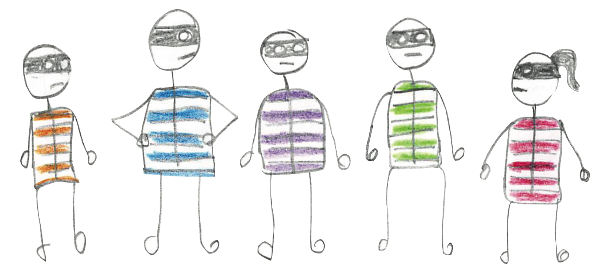

November
2016
Time Theft – How Hidden & Unplanned Work
Commit the Perfect Crime
Dominica DeGrandis - Director, Training & Coaching
Notes:
It’s been my pleasure for many years now to help ppl make their work visible. I teach teams how to see and to measure the problems that prevent them from getting things delivered. It doesn’t matter if 50 person… or 150k, everywhere suffers from time theft. Provide you with some countermeasures to deal w/ 5 thieves that rob us of our time.

Slide 2
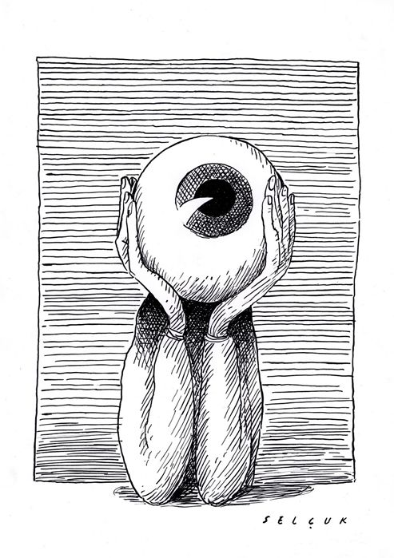
How to make uncertainties visible
Notes:
There’s reason our offices are plastered w/ whiteboards. We are visual learners. When we bring our visual sense to solving problems, we get clarity and
it’s easier to make decisions. So – let’s have a look at how to make these thieves visible so we can do something about it.

Slide 3
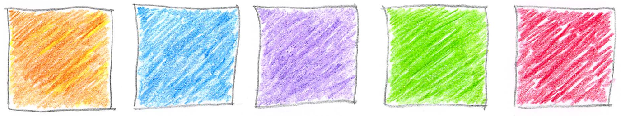
5
The
Thieves
Unplanned
work
Neglected
work
Unknown
Dependencies
Conflicting
priorities
Too much
WIP
Notes:
There are 5 thievs that if we could see & measure the impact of, could help us improve perfor. UNPLND: sneaky thief – these turn into fires. NGLCTD: these are important, but get benched by urgent work. DEPen – these have a high coordination cost. Very expensive thief. CONFLCT pri – This is when Brent says yes to everyting. Thief too much wip – Ring leader. Now, B/c under time constraint, I need to prioritize. For ea thief, give you essential bit of info you need to know. Now that I’ve introduced all 5 thieves, lets look at the ring leader 1st - too much WIP.

Slide 4

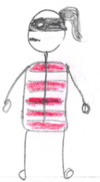
thief #1 – TOO MUCH WIP
When demand exceeds capacity
capacity
demand
Notes:
In text book terminology, too much WIP is when the demand on the team exceeds the capacity of the team, which is a rather boring way to say that our teams are drowning in work. Often b/c they’re fully allocated to 100% resource efficiency. Equates to ppl doing full time job on top of troubleshooting 2 hosts gone missing. People can’t even get started on their to-do list until 6pm. We don’t let our servers get to 100% capacity utilization, why do we let our people?

Slide 5
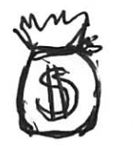
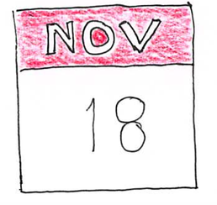
WHY TOO MUCH WIP Matters
Effective people say yes deliberately
Too much WIP delays work
Notes:
It matters b/c when we take on more new work before finishing old work, things take longer to do – CT goes up and so does CoD!
If you can’t deliver a new feature b/c another request gets added on, there’s a cost for that delay. And on top of that, WIP is a leading indicator.

Slide 6
WIP is a leading indicator
Notes:
MTTR, velocity LT, CT, TP – all trailing indicators. There’s a relationship between the numbers of things in your work Queue and CT. It’s called Little’s Law and it’s why the primary factor of time is the amount of work-in-progress. Freeway.

Slide 7
You know Thief #1 steals time when...
Context switching is common.
We start new tasks before finishing older tasks.
Work gets neglected and ages.
We say, “Yes, I’ll do that.”
Molecules Of Emotion: The Science Behind Mind-Body Medicine, Candace B. Pert, 1999
Notes:
When you find yourself context switching all the time, Or when you get asked that that 5 word Q – do you have 5 min, and, “ you say…. yes!” Liz sends me a slack msg – “hey, what do you think abt this?”… end up working late. I teach this stuff & I fall into trap too. So annoying. We do get more endorphins from saying yes – even grouchy ppl want to say yes. But it’s not SUSTNBLE to work evenings & weekends all the time.

Slide 8
EXPOSE WIP
https://docs.google.com/spreadsheets/d/1UKjHHM7Y-emzSo4p0RLhzLaIR4Yp3owWR3JdT5QghoY/edit#gid=0
Study
Build/
fix
feedback
delivered
cycling done
Silver Bullet
(1)
Team
work
(3)
Business requests
(5)
Notes:
Hold ea other account w/ transparency. 3 swim lane board (SB, Team wk, Biz requests) - ea ln has own WIP limit. SB requests – come directly from CIO. Sometimes called VP ln. Rpt, interview. It’s good to viz. They don’t know the disruption. They get 1. Team work – I call this REV protection wk – fix tech debt. SEC work. Biz requests – this is REV generating work. Shaded pink, b/c gone > WIP of 5 & now, other ppl can say, “what’s going on?” Helps when others keep us honest. Diet. Feedback stuff not delivered yet, take longer. If you want to be more predictable, then limit WIP to the team’s capacity.

Slide 9
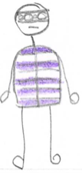
thief #2 – UNKNOWN DEPENDENCIES
Time delays due to:
Tightly coupled architecture
Bottlenecks from specialized skillset
Work outside of our control
Notes:
Architecture is a major target of thief #2. A friend of mine works for a $23 billion company where product Team X deployed a component that broke Team Y’s product. And now team Y’s customers have to fork out $5 million on the new part. They have a PR disaster & are losing significant market share b/c 2 product team didn’t talk to ea other. Team Y had zero visibility into that decision. It’s very expensive when teams are mutually unaware of critical information.

Slide 10
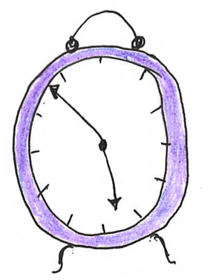
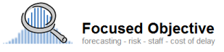
WHY DEPENDENCIES MATTER
Every dependency increases the probability that you will be late by 50%.
Dependencies are asymmetrical in their impact.
Troy Magennis
Notes:
Imagine you go out to dinner with 4 ppl at a fine dining restaurant – there are 16 possible outcomes. If chart out, that’s a 1 in 16 chance to to be seated on time. Dependencies asymmetrical in their impact. W/ 4 dependencies, it’s not a 25% probability you won’t be seated. It’s 93% prob. b/c greater chance of 15/16 outcomes happening.

Slide 11
Dependency x 3
you | friend | brother
X
 | X
X | X
 |  | X
X |  | X
 | X | X
X | X | X
1 chance in 8
= 12.5% of
arriving on time
Notes:
Here’s chart to visualize that. This 1 is for 3 dependencies where probability is 12.5% of being seated on time. When you add 1 more dependency, it’s 1 in 16 – or .06% probability. Unless, they work in Ops – then they’ll never leave work in time to get their on time.

Slide 12
You know Thief #2 steals time when...
Coordination needs are high.
People aren’t available when you need them.
A change in one part of the code unexpectantly changes something else.
Notes:
When the local pizza company delivers > 2 pizzas to the same meeting room. If three 2-pizza teams need to have a joint mtg to discuss their dependencies on each other, then you got high coordination costs. Or when a chg to your tool bar changes your filter functionality. In general – when ppl are not avail when you need them.

Slide 13
EXPOSE DEPENDENCIES
investigate
waiting
feedback
delivered
Expedites or
Unplanned
Dependencies
_{8 days}
Everything else
Notes:
Show of hands – how many have a dependency matrix? Keep up if involves string. Keep up if still accurate. The hardest thing we do is communicate across teams & when bunch of 2-pizza teams w/ lots of dependencies between them, how much time spent coordinating? We like small teams b/c they can move fast – it’s true. Just realize that by moving fast as an individual team, you’re paying a price of not moving very fast as a whole organization.

Slide 14
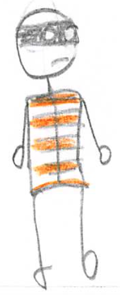
thief #3 – UNPLANNED WORK
An Interruption –
usually to fix a problem
Ex: Break fix, expedites, incidents, fires
Notes:
Sometimes unplanned work come in the form of strategic chg in direction “stop marketing to everyone, just focus on lg enterprises.” But often comes in the form of expedites, fires that stem from some failure – call that failure demand. It seems to come out of nowhere – where where you when DYN got DDos’d?

Slide 15
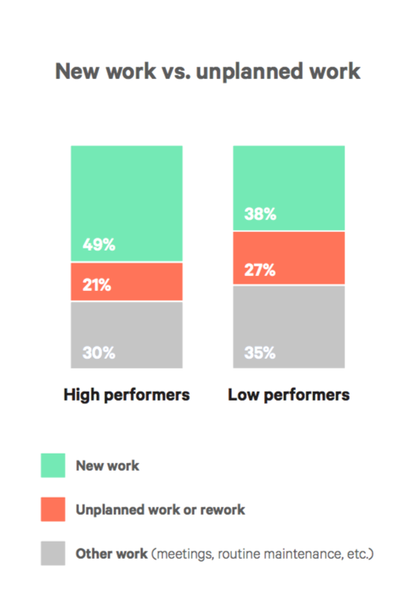
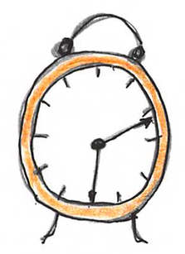
Why Unplanned Work MATTERS
Unplanned work steals time away from planned work.
https://puppet.com/resources/white-paper/2016-state-of-devops-report
Notes:
Unplanned and expedited work steals time away from work that’s creating value. State of DevOps 2016 rpt (on left) survey data here shows that high performers spend 11% more time working on planned work vs. unplanned work and considers the amount of unplanned work a measure of quality - b/c the more unplanned work, the less time for creating value work. All hands on deck incidents tend to reduce performance.

Slide 16
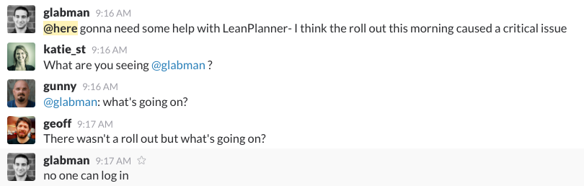
You know Thief #3 steals time when...
Someone joins your slack channel and within 2 min, 4 people are sucked into the vortex.
Notes:
Events like this critical issue where no one can log in, add variability into our everyday work. B/c of this interruption, something else is going to take longer than expected. If the work is frequently late, chances are, thief unplanned work (failure demand) is stealing not only your time, but your predictability away.

Slide 17
To do
doing
validate
done
Unplanned
work
Planned
work
EXPOSE UNPLANNED WORK
Notes:
This board brings vis to UNPLND wk. A way to visualize things that interrupt your day – take you away from delivering important value b/c you are putting out fires. There’s usually resistance to this – comes in form of PLTFRM Ops Mgr Erik saying, “I don’t have time to log a ticket every time I get INTRPTD!” But after weeks of interruptions, the CIO wants to know why Azure isn’t up & running in production, & what does Erik say? Been busy. If not tracked, there’s no evidence. It’s a perfect crime. When unplanned work is made visual, other ppl can see & understand why work didn’t get done.

Slide 18
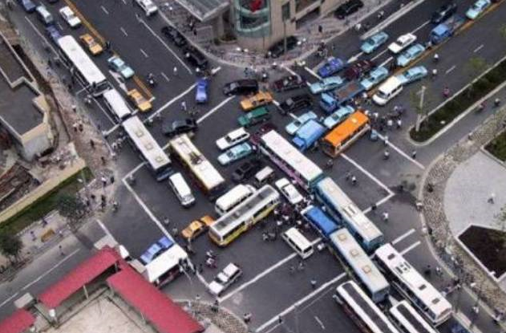
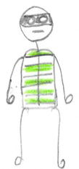
thief #4 – CONFLICTING PRIORITIES
Conflicting priorities are when people are uncertain or disagree on what to work on.
Notes:
Working w/ MKTG team. DevOps in starting to spread to biz teams in companies. Working on a rpt – was taking ages – delivered 6 months later than leadership wanted. So, we looked at all their demand. Turns out they had 13 initiatives, which was more ppl than they had on the whole team. And, their priority meetings were long an hour – every week. Reduced initiatives to 7 and now they got better focus and pri mtgs are shorter. One cause of too much WIP is failure to prioritize properly.

Slide 19
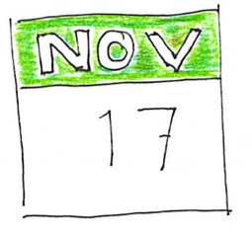
WHY conflicting PRIORITIES MATTER
If people can’t prioritize effectively, they try to
do too much at once.
Too much wip = longer Cycle Time.
Notes:
If everything is a priority 1, then nothing is a priority 1 - and everything takes too long. It could be that the greatest value for the business today would be for me to go help Julia finish this A3 training she’s working on instead of me starting a new training workshop. When ppl can’t prioritize effectively, we try to do too much at once and this causes too much WIP which causes longer CT.

Slide 20
You know Thief #4 steals time when...
“When will my thing be done?”
“My thing is a high priority!”
“If my thing doesn’t get done by ____,
then…
Notes:
When you spend countless hours in meetings discussing priorities. When you keep adding more new work to your work queue before finishing old work. When Ppl ask “when will my thing be done?” Thief #4 is a close cousin of unplanned work.

Slide 21
EXPOSE CONFLICTING PRIORITIES
mainmnai
To do
doing
validate
delivered
Expedites
Project 1
work
Project 2
work
Maintenance
work
On-hold
work
Notes:
Here’s a way to see the things that are conflicting with ea other. Got UNPLND expedites, project work, maint – it’s all competing with ea other. When work goes on hold, b/c someone says do this other thing now – show that. Show that implementing the new security vulnerability fix got de-prioritized b/c ppl had to do merit reviews. The idea is to makes prioritization policy explicit. Otherwise how made? By the loudest? HIPPOpinion? CoD?

Slide 22
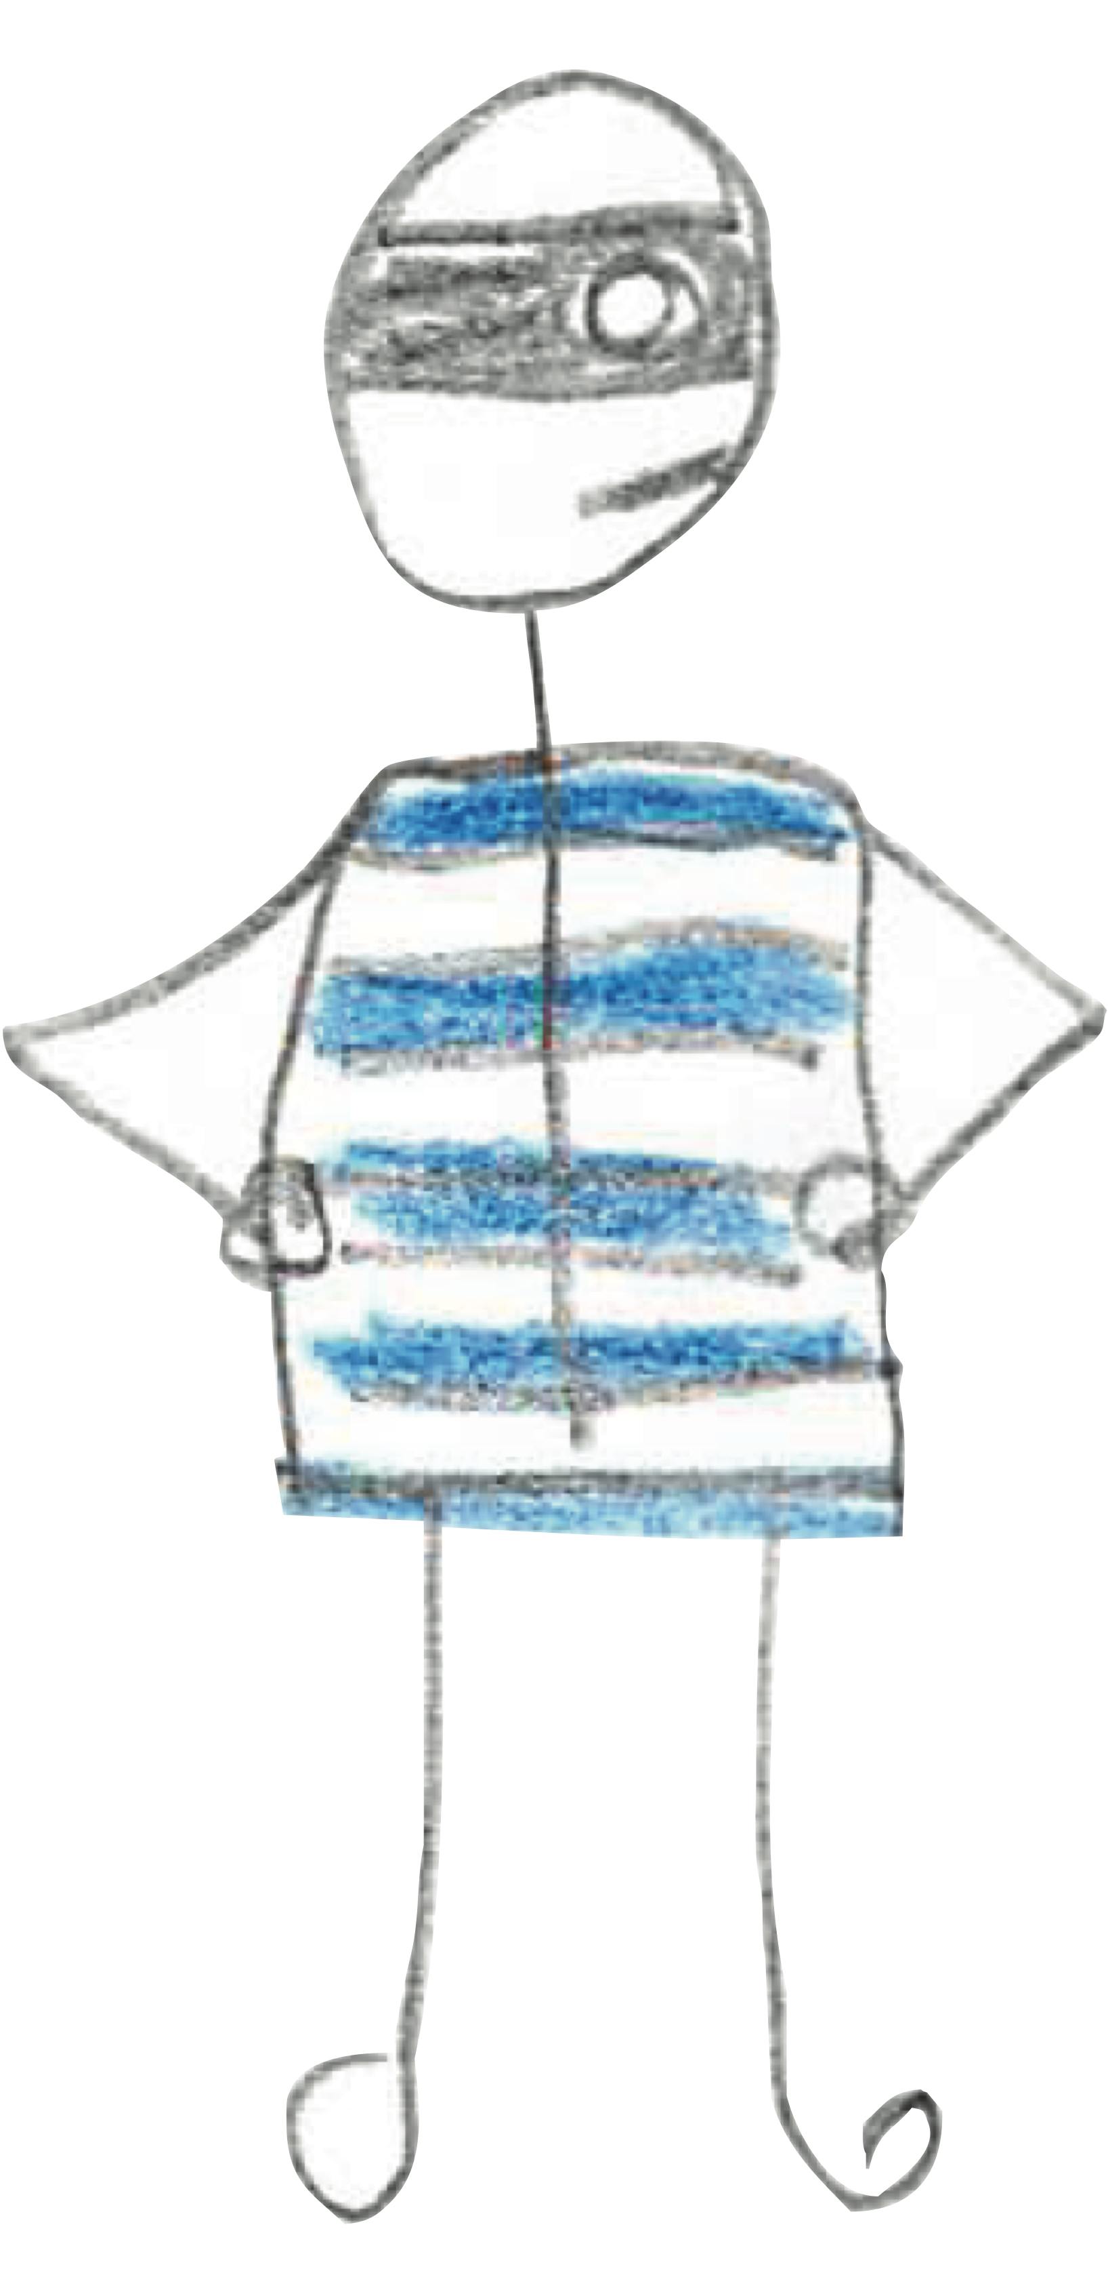
thief #5 - Neglected WORK
Neglected, often important work sits idle when other work is seen as a higher priority.
Notes:
NGLTD work is the PLND work that gets delayed often b/c Biz wants to work on value demand over failure demand. The new feature release get’s prioritized over fixing tech debt. Thief 4 & 5 are close cousins. Neglected work doesn’t get the attention, or budget, or the resources needed to be successful.
Ex: Like getting rid of all the xp machines in your environment.

Slide 23
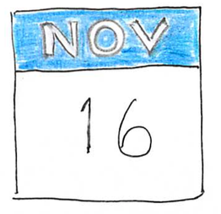
WHY neglected WORK MATTERS
Important work sits waiting – until it eventually becomes an emergency.
Notes:
Important work sits waiting – until it eventually becomes an emergency, or it causes distractions, interruptions… Neglected work is perishable. It ages - and like rotten fruit, it’s wasteful. Fruit’s expensive these days, consumes space on the countertop, and gets old and moldy and smells bad. If you don’t change the oil in your car, you eventually end up with a blown up engine.

Slide 24
You know Thief #5 steals time when...
“When are we going to finish x?”
“We can’t get to x right now, because we’re working on y.”
Notes:
You delay important things that will eventually become emergencies.
It’s like taking your better half out for your anniversary dinner, but then decide to just batch it up w/ next years anniversary.

Slide 25
EXPOSE neglected WORK
To do
doing
validate
5
done
Expedites
Unplanned work
Revenue protecting
_{9 days}
_{13 days}
Revenue generating
Notes:
Revenue protecting work is a major target of Neglected work. Here’s a way to see the things that are sitting on the bench…. Then you can create aging reports. Query everything in your system that hasn’t been touched for 30 days. The guidance with neglected work is to make it transparent on your board.

Slide 26
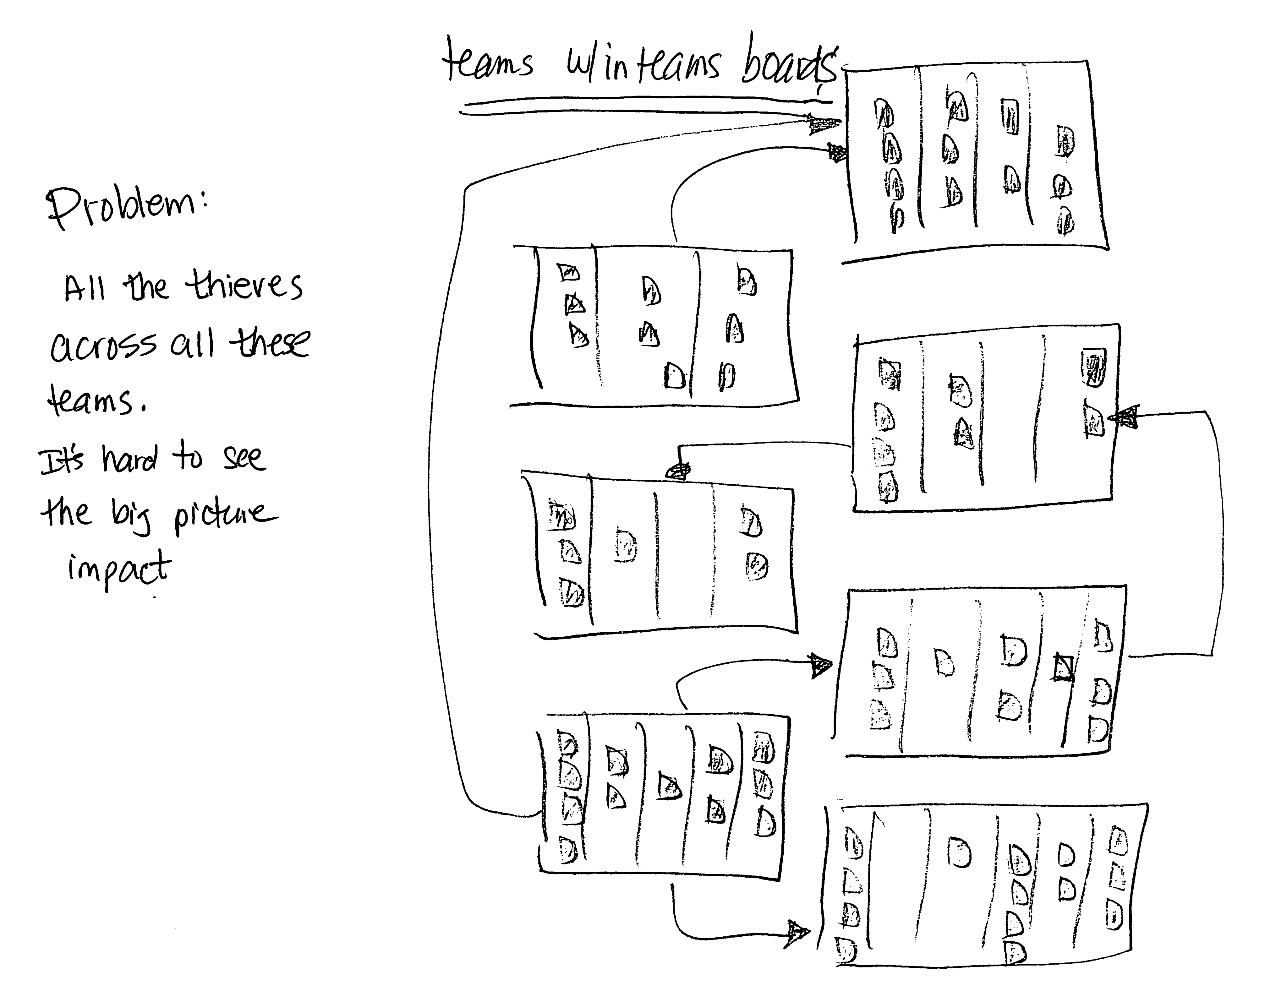
Notes:
It’s hard to see the big picture impact when all the thieves are secretly attacking the teams.

Slide 27
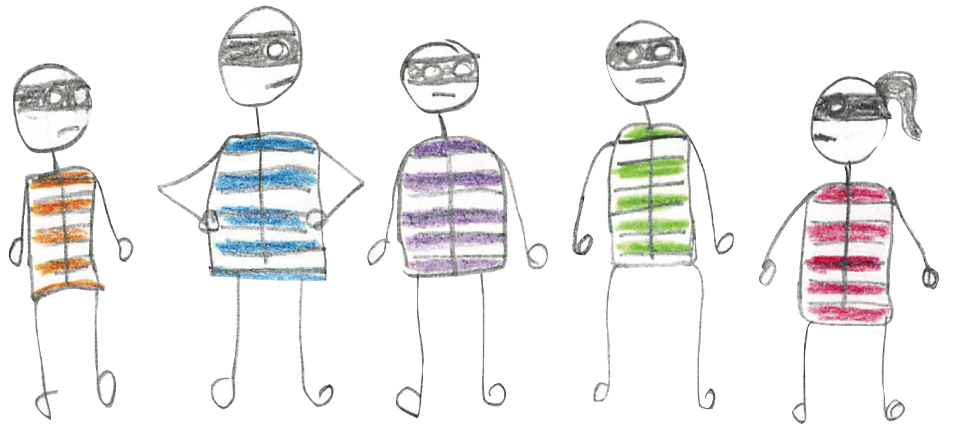
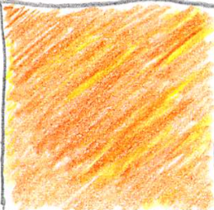
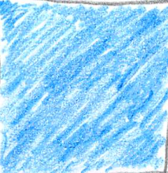

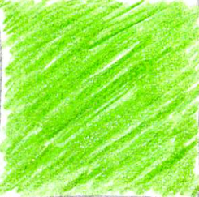
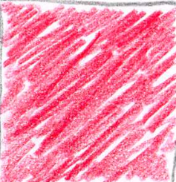
5
The
Thieves
Notes:
But if you can shine a light on them – and expose them, by tagging them, then… we can use our visual senses to discover how to put these thieves out of biz.

Slide 28
ALL THE TIME THIEVES EXPOSED
5
Next
doing
validate
delivered
Expedites
Revenue protecting
Revenue generating
Notes:
Here’s an idea. Tag all your thieves on your kanban board. Yellow is unplanned work. Red is when you went over your wip limit. Purple are the UNKWN dependencies, etc… Once you have all these tagged, you can visualize & count them.
You can begin to see patterns and connections that would otherwise be scattered across multiple team boards.

Slide 29
THE TIME THIEF O’GRAM
20
15
10
5
1
Unplanned
work
Neglected
work
Unknown
dependencies
Conflicting
priorities
Too much
WIP
Notes:
This is the time thief o’gram. It’s brand new idea of mine & incomplete. I’m looking for help to nail down specifics, I think it could be very useful. The intent here is to focus on the info that’s really important. A lot of you measure velocity, MTTR, defects. I’m gonna argue that we need to measure the things that cause those problems in the first place. Stuff that prevent your teams from getting work done quickly. UNPLND work, NGLTD work & UNKWN wk are intended to be the # of cards tagged across multiple boards. The other two thieves - Conflicting priorities & too much WIP need cards based on some criteria. If we can count these things & measure we can see where our time is going.

Slide 30
AGGREGATED TIME THIEF O’GRAM TREND
20
15
10
5
1
Oct 3 Oct 10 Oct 17 Oct 24
Notes:
Can look at this aggregated trend week over week or month over month. We could see the fluctuation in the amount of uncertainty across the system. This view though will prolly be too difficult to manage b/c the height of the diff bars are not of equal damage. Don’t know if this neglected work here in blue caused more damage than the unplanned work in yellow. Seeing all 5 adjacent might lead people to focus on the highest bar, not the most impactful thief?

Slide 31
CONGREGATED TIME THIEF O’GRAM
OCTOBER, 2016
20
15
10
5
1
Unplanned
work
Neglected
work
Unknown
dependency
Conflict
priority
Over
WIP
Notes:
Or we could congregate them so can compare like for like.

Slide 32
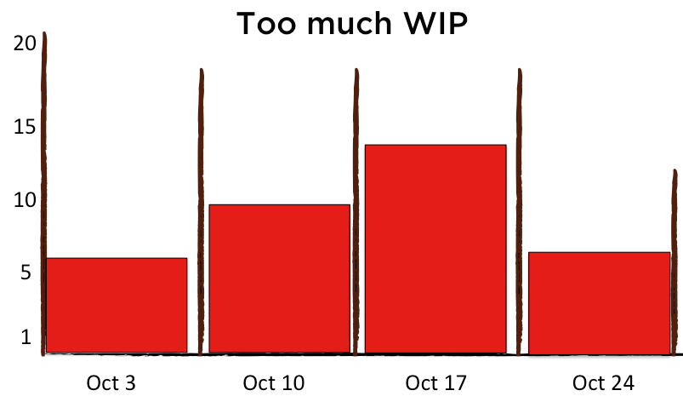
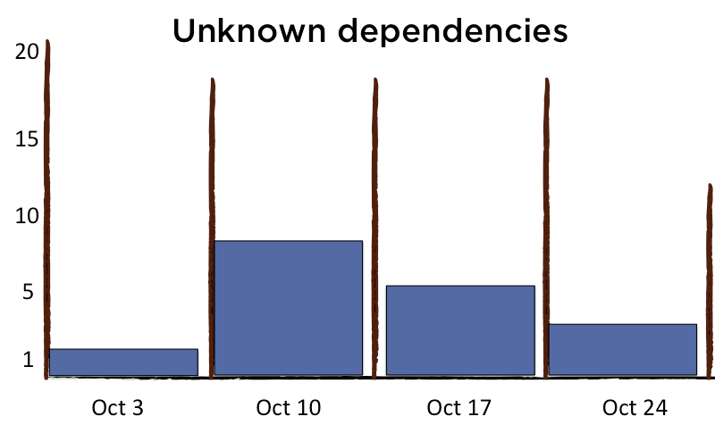
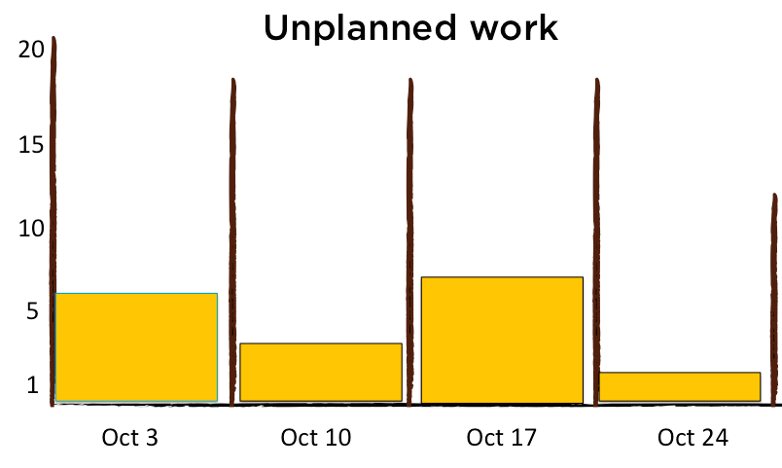
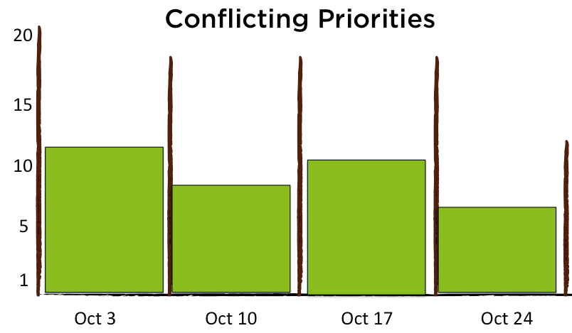
Notes:
Viewing it as a balanced score can help ppl understand which thieves to focus on 1st, which ones you are doing well with and which ones are robbing you of time & predictability left & right. When we track these thieves & measure them, we can now do something about it. Yesterday’s Lean Coffee Q – how to influence CIO? What metrics to get buy in? CIOs I’ve talked to want 2 things: Predictability and Reduced risk. The thief O’Gram shows risk (actually uncertainties, since risk is in the eye of the beholder.) And, the Thief O’Gram shows WIP – and since WIP is a leading indicator, we can see predictability here. What would it be worth to your CIO to have this kind of transparency?

Slide 33

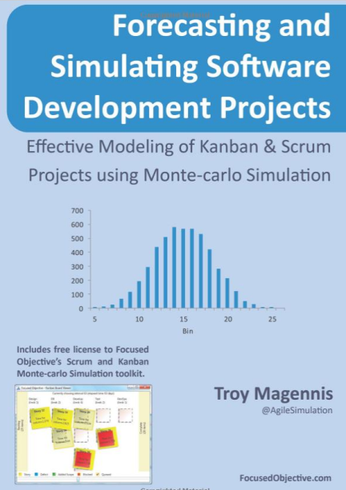
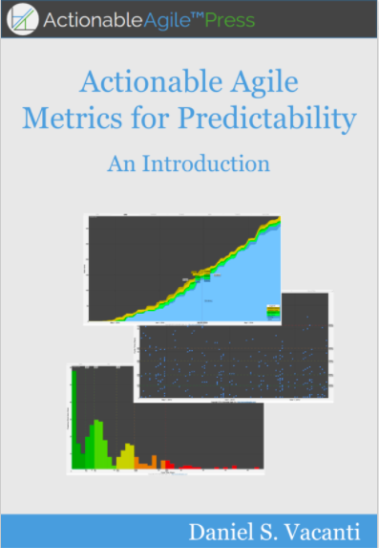

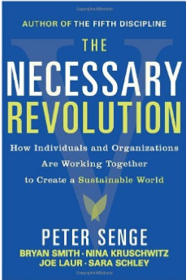
MORE ON TIME THEFT & UNCERTAINTY

Slide 34
TO RECEIVE THE FOLLOWING:
A copy of this presentation
A copy of the Kanban for ITOps white paper
A discount code for DevOpsDays Seattle 2017
A copy of the Lean Kit Lean Business report
Just pick up your phone and send an email to: dominica@leankit.com
Subject: Flow

